Slide 1
Academic Registry
Kate Whelan
Service Desk Supervisor
Academic Registry
Trinity College Dublin, The University of Dublin

Slide 2

What is the Academic Registry?

Slide 3


Documentation
Available in your my.tcd.ie portal
Proof of registration letter which can be used for:
  Bank account set up, PPSN application, IRP Application, Proof of Address
Documents provided by Academic Registry
  Validation of forms to confirm your student status
  Transcripts – Postgraduate Research, Undergraduate & Visiting
  Student History letter
  Government Funding Forms
Your student record
You can update home & term addresses and contact numbers at any time in my.tcd.ie - Maintain Student Record.
Details such as name, gender, date of birth or nationality - can only be updated by the Academic Registry, once a student has registered. Complete a Change of Personal Details Form and submit it along with official documentation.
Note – Where any name changes have been completed, a new student card can be issued free of charge, once the update is in place.

Slide 4
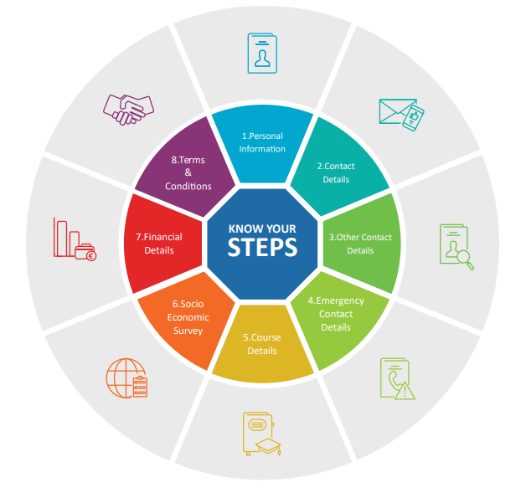
Student Registration
Register online at my.tcd.ie.
Students will be taken through an eight-step process – make sure to complete all steps fully or you will not be deemed registered!
The reasons you might not be able to complete registration:
Garda Vetting outstanding
Funding or scholarship outstanding
Departmental Waivers outstanding
The deadline to complete registration is 6th October. You will continue to receive automatic reminders and warning messages up until that date – DO NOT IGNORE.
If you continue to have any difficulty registering as we approach the deadline, reach out to us by logging an enquiry at ask.tcd.ie.

Slide 5
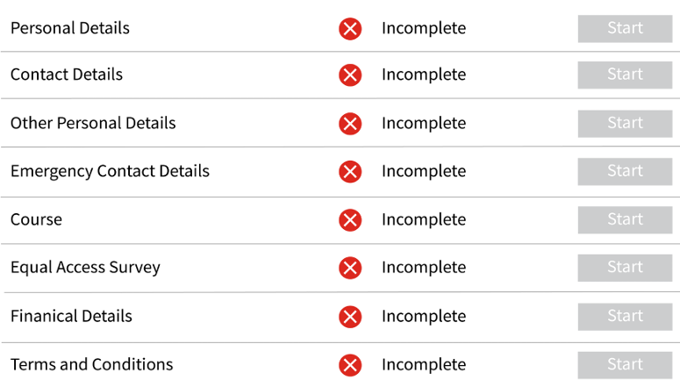
Registration Tasks:
Below is an example of how my.tcd.ie will appear when registration opens. Any task yet to be completed will be marked with a red X as shown below. Once a task is completed, a green tick will appear.

Slide 6
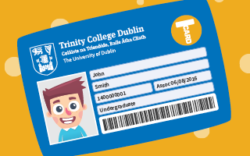
Student ID Card
After completing registration you can apply for your Trinity ID card (TCard).
You should upload your passport style image at www.tcard.tcd.ie, and your card can be collected from the Orientation Hub, located in front square, 48 hours later. Bring a hard copy of your ID (driver’s licence, passport, national identity card) when collecting your card.
When you get your card, it’s ‘good to go’ and ready for building, gym and library access. If you wish to load money on to the card go to the TCard website and you can top up there from Monday the 14th September.
If you lose your ID card, come to the Academic Registry Service Desk for a replacement for a fee of €20.

Slide 7
Practical tips and what to keep in mind
Register early: Don’t delay registration. Until you register, certain services (such as ID card, sports centre access etc.) will not be available to you.
Keep track of deadlines: For module enrolment, fee payments etc. Missing deadlines may cause problems.
Check your email and my.tcd.ie regularly: We will send important information through my.tcd.ie (intray messages) and to your Trinity email address.
Ask questions: If you’re unsure about something: The Service Desk team are there to help.
Keep copies of your letters/documentation: Proof of registration, transcripts etc. are useful for many purposes outside of college (bank, PPSN, visas, internships, etc.).
If something goes wrong (withdrawal, illness, missing exams): Contact your Course Admin/ Supervisor straight away and they will engage with our Student Cases team on your behalf.
Know your support options: The Academic Registry is one piece of the support structure in Trinity. There is also Student Learning Development, Disability Service, Counselling, Student Union etc. If you need help, don't wait to reach out.

Slide 8
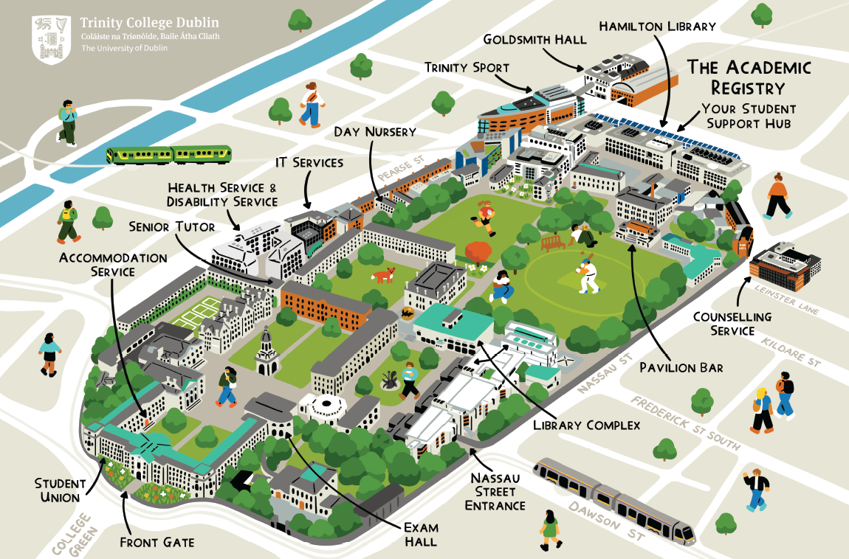
Our Location on Campus
We are located in the Watts Building at the East End of campus.
If you need to post any documentation please send it to:
Academic Registry,
Watts Building,
Trinity College,
Dublin 2
Submit enquiries at ask.tcd.ie 🌐💌✉️📩
Call us on +353 1 896 4500 ☎️📞📱📲

Slide 9



Thanks!
@tcd_academicregistry
Academic Registry Trinity College Dublin
Academic Registry - Trinity College Dublin

Slide 10
Best of luck in your time at Trinity!
Notes:
HK

